Slide 1
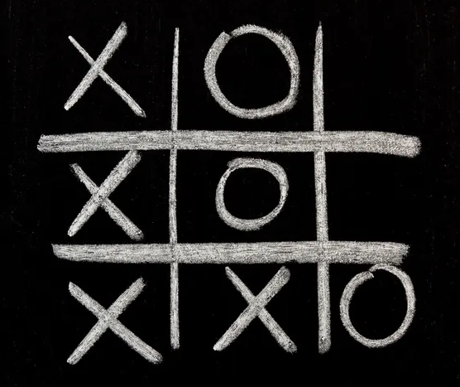
“The Game of Noughts and Crosses”
group 21216
Tatarintsev Vladislav
Makhov Nikolay
Pogibelnaya Olga

Slide 2
Introduction

Slide 3
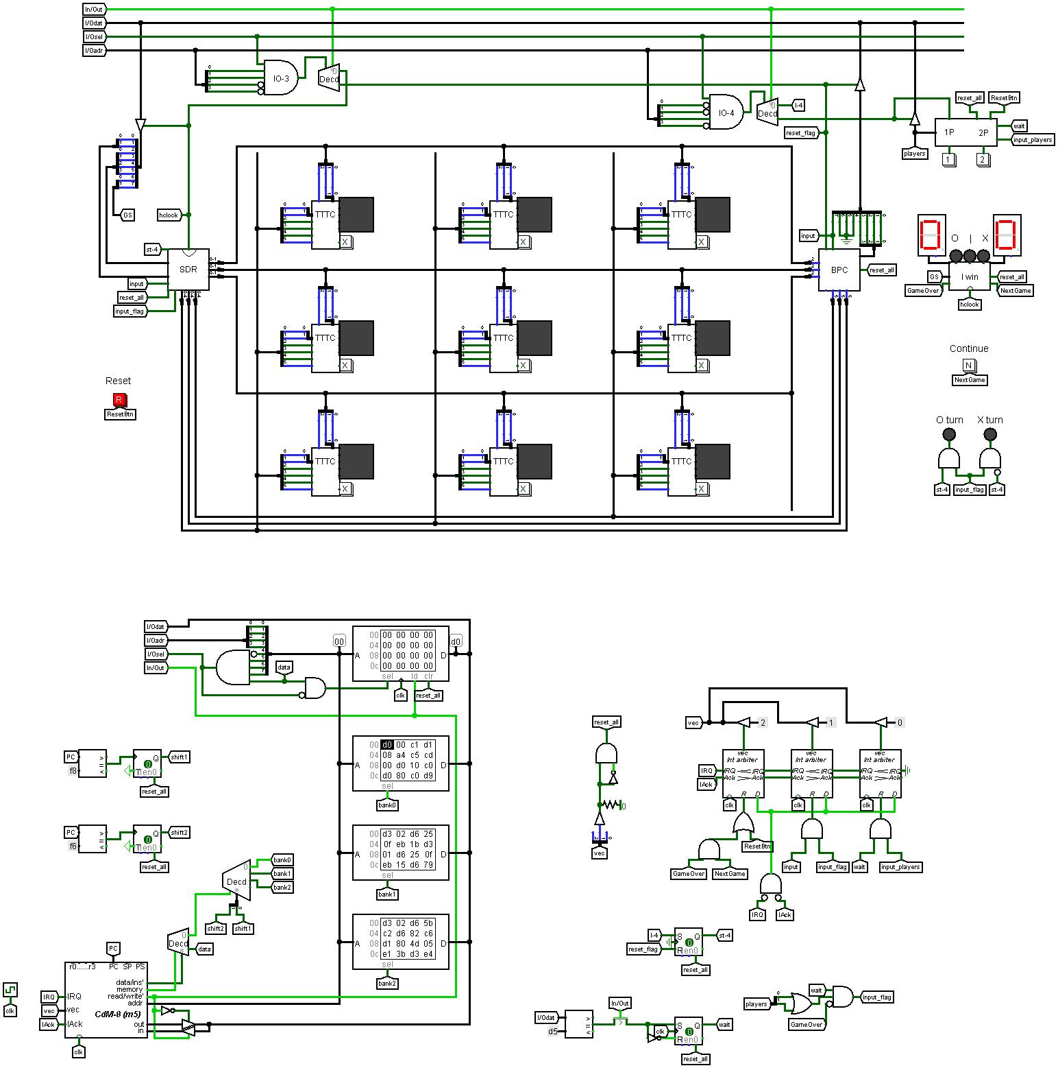

Slide 4
Gamepad

Slide 5
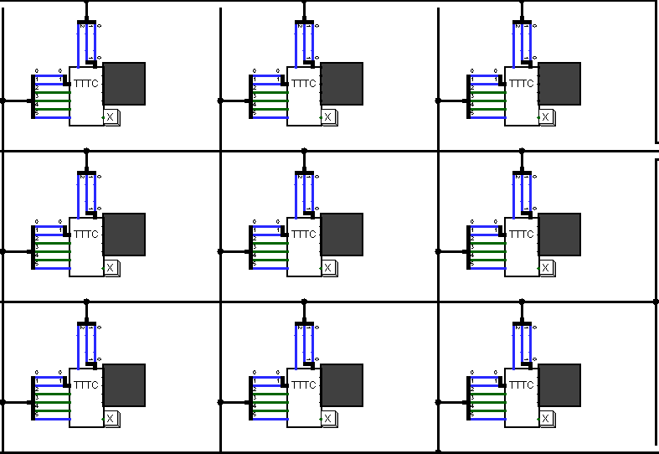
Playing field

Slide 6
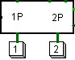
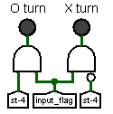
Game mode selection panel
Player move indicators

Slide 7
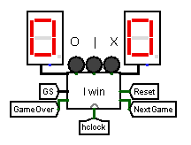
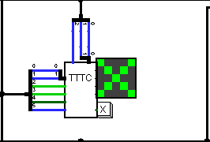
Cell with a cross
Game state display driver

Slide 8
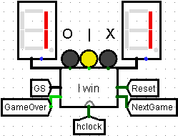
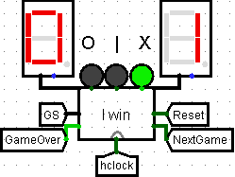
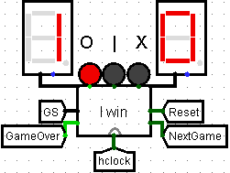
Draw
Crosses win
Noughts win

Slide 9
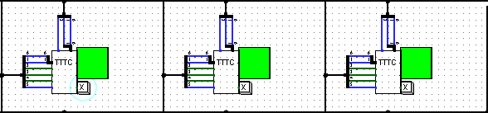


Illuminated row
Button “Reset”
Button “Continue”

Slide 10
Hardware improvements

Slide 11
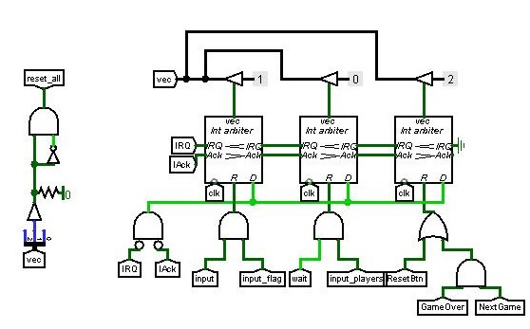
Interrupt arbiters

Slide 12
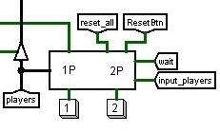
Count of players chip

Slide 13
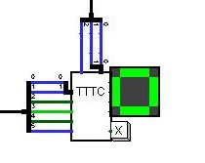
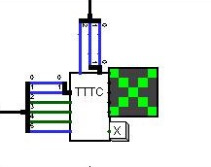
Symbol switching bit when playing between two players

Slide 15
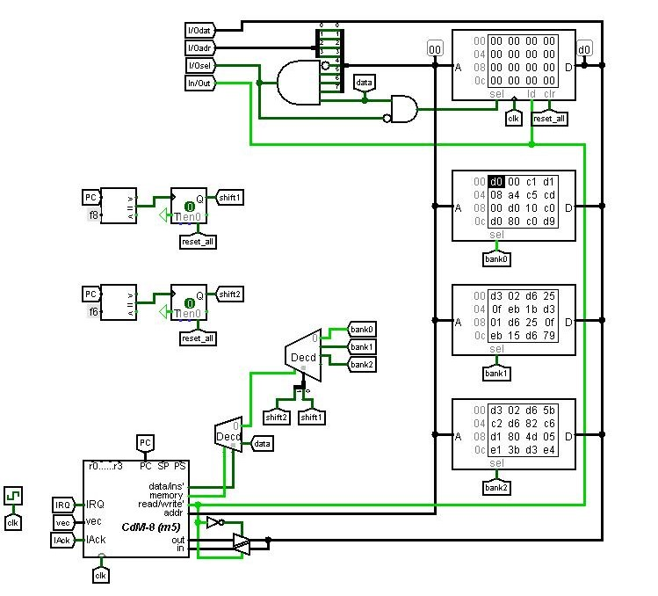
Banks of data

Slide 16
Software

Slide 17
Заключение Какие нововведения и за сколько времени всё работает

Slide 18
